Slide 1
PRODUCT MANAGEMENT
Training course
Adam Zydower & Katie Round

Slide 2








PRODUCT BOOTCAMPS
A one-day interactive bootcamp which covers the essentials of product training and what makes a successful product team.
Skills
Product goals and vision
MVP
Roadmap
Customer feedback
Prioritisation
Metrics and analytics
Release planning

Slide 3
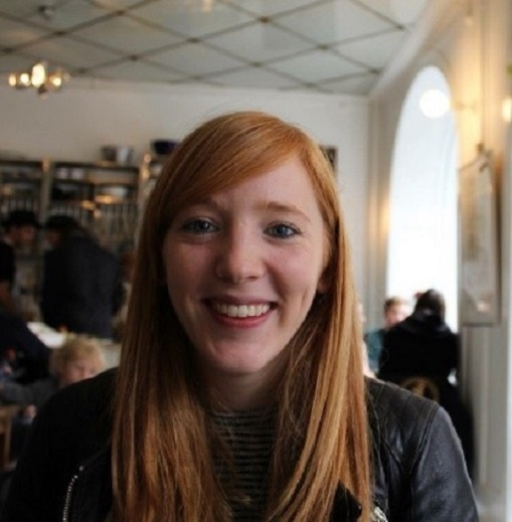










OUR EXPERIENCE

Slide 4








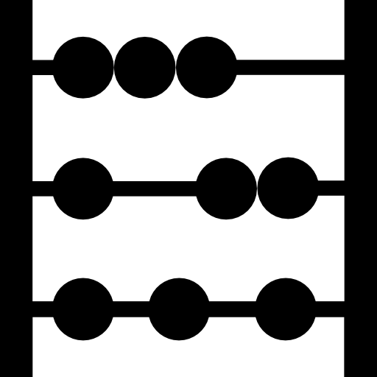


YOUR AGENDA - THE PRODUCT JOURNEY
Introduction
Agile refresh
What makes a good PO/PM?
Product vision
Prioritising the backlog
MVP/MLP
Refinement
Estimation
Managing a sprint
Product roadmap

Slide 5

A FEW QUESTIONS
What is your favourite digital product & why? Do you have PO/PM experience? What do you want to take out of today’s Product Management training?

Slide 6


YOUR AGENDA - THE PRODUCT JOURNEY
Introduction
Agile refresh
What makes a good PO/PM?
Product vision
Prioritising the backlog
MVP/MLP
Refinement
Estimation
Managing a sprint
Product roadmap

Slide 7
AGILE MANIFESTO
Individuals and interactions
Processes and Tools
Working Software
Comprehensive Documentation
Over
Customer Collaboration
Contract Negotiation
Responding to Change
Following a Plan
That is, while there is value in the items on the right,
we value the items on the left more.

Slide 8



AGILE VS WATERFALL
AGILE
WATERFALL
Time
Time
Cost
Cost
Scope
Scope
VS

Slide 9





THE TEAM
Product Owner
Scrummaster
Team Member

Slide 10

YOUR AGENDA - THE PRODUCT JOURNEY
Introduction
Agile refresh
What makes a good PO/PM?
Product vision
Prioritising the backlog
MVP/MLP
Refinement
Estimation
Managing a sprint
Product roadmap

Slide 11

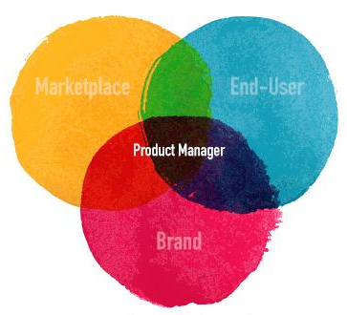
List Product Manager characteristics
ACTIVITY
EXERCISE
5 mins
5 mins

Slide 12
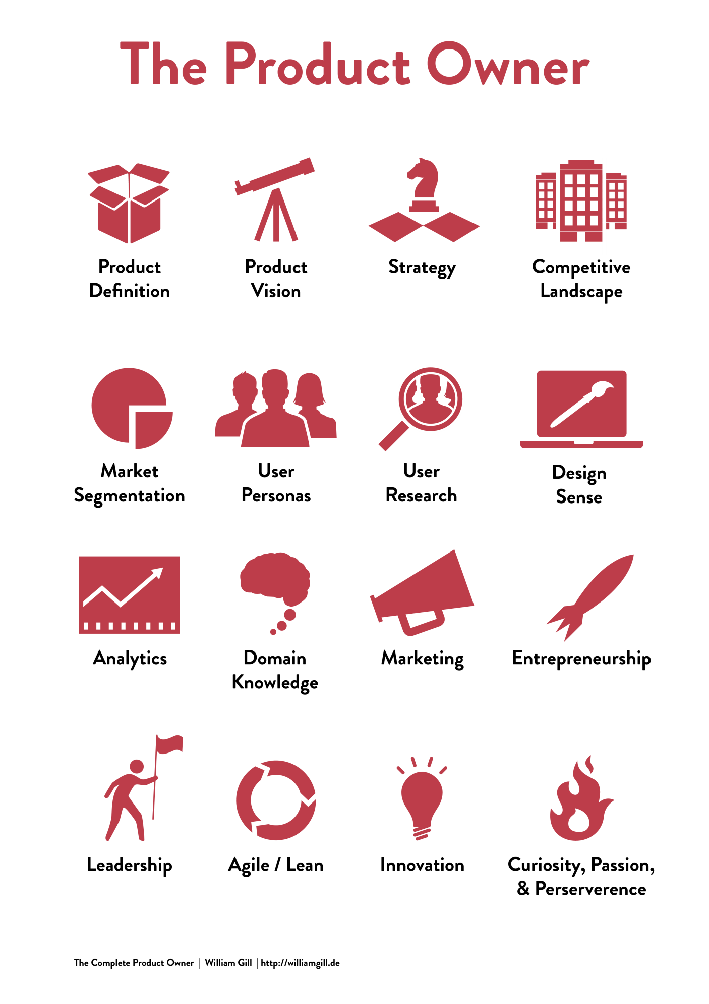
PRODUCT MANAGER CHARACTERISTICS

Slide 13
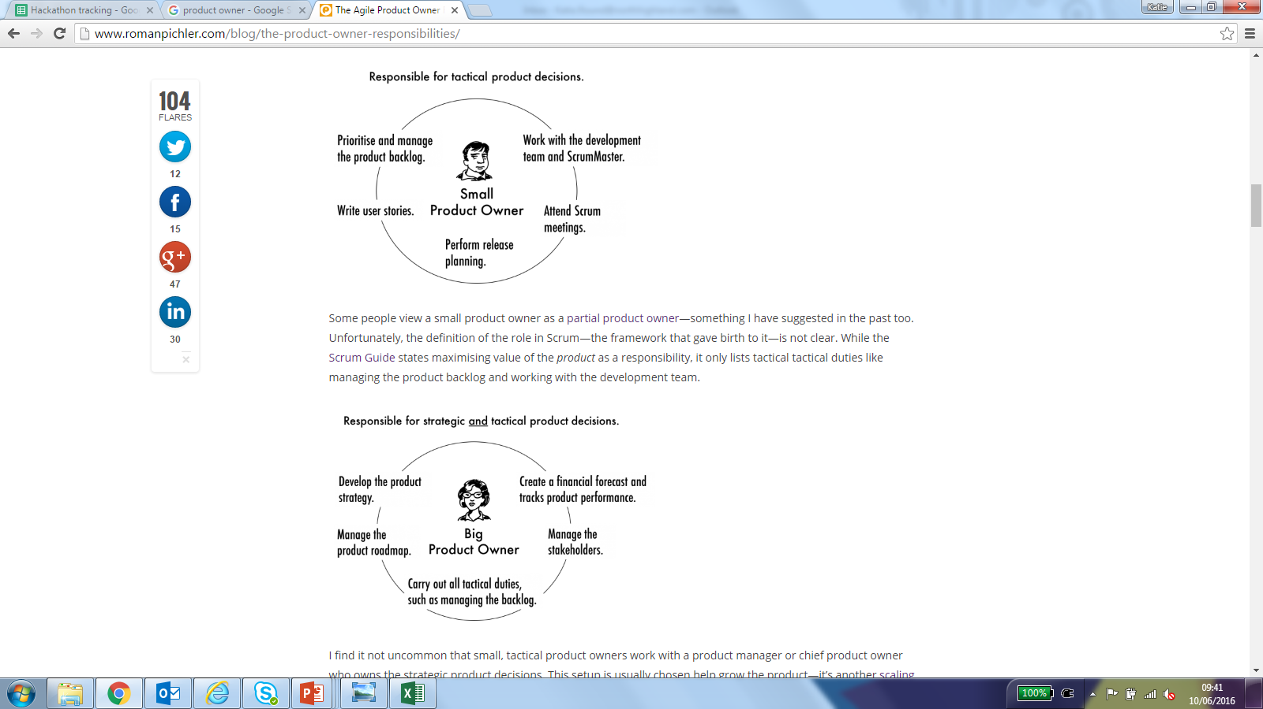
RESPONSIBILITIES
Tactical
Strategic

Slide 14
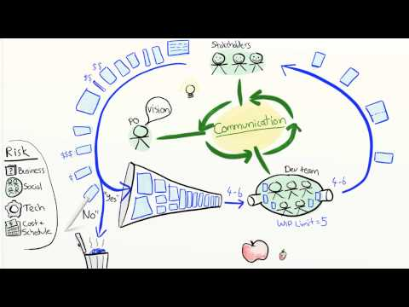
Notes:
Run to 5 mins 40 seconds.
RuVideo - https://www.youtube.com/watch?v=502ILHjX9EE

Slide 15

YOUR AGENDA - THE PRODUCT JOURNEY
Introduction
Agile refresh
What makes a good PO/PM?
Product vision
Prioritising the backlog
MVP/MLP
Refinement
Estimation
Managing a sprint
Product roadmap

Slide 16
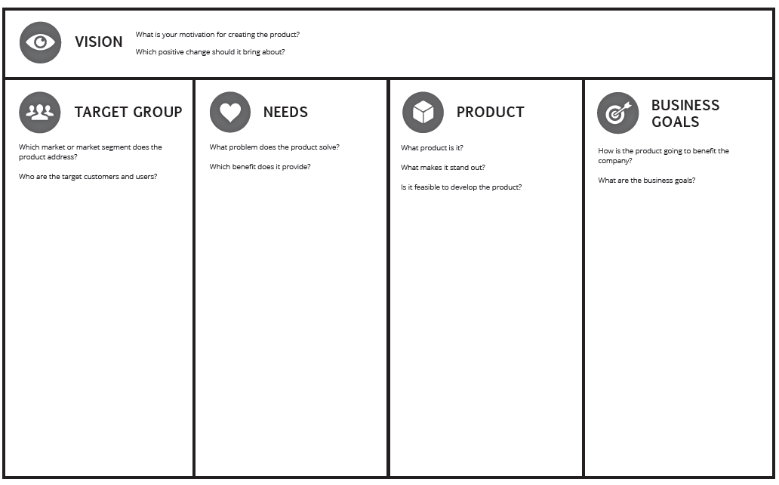
PRODUCT VISION

Slide 17

Build your product vision Case study tailored to group
ACTIVITY
EXERCISE
5 mins
20 mins

Slide 18
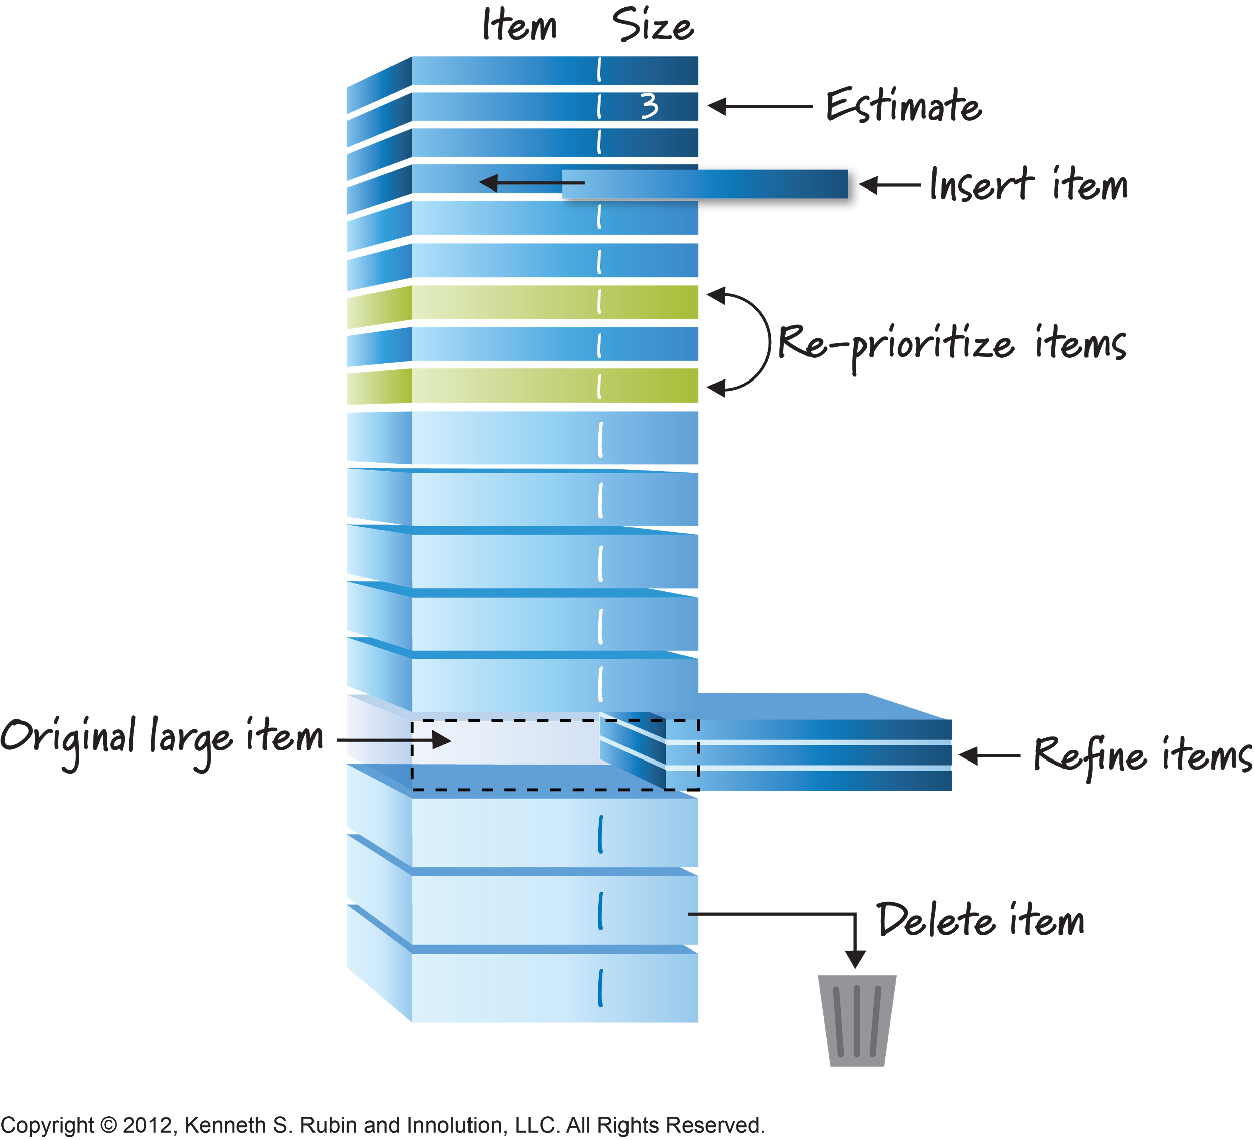
THE BACKLOG
Contains all items that could be delivered as part of the product in different states of readiness
Visible across the team & departments
The backlog is never ‘complete’ ‘baselined’ or ‘signed off’ - it is ever evolving
Notes:
Contains all possible parts of the product
Visible across the team & departments
The backlog is never ‘complete’ ‘baselined’ or ‘signed off’ - it is ever evolving

Slide 19
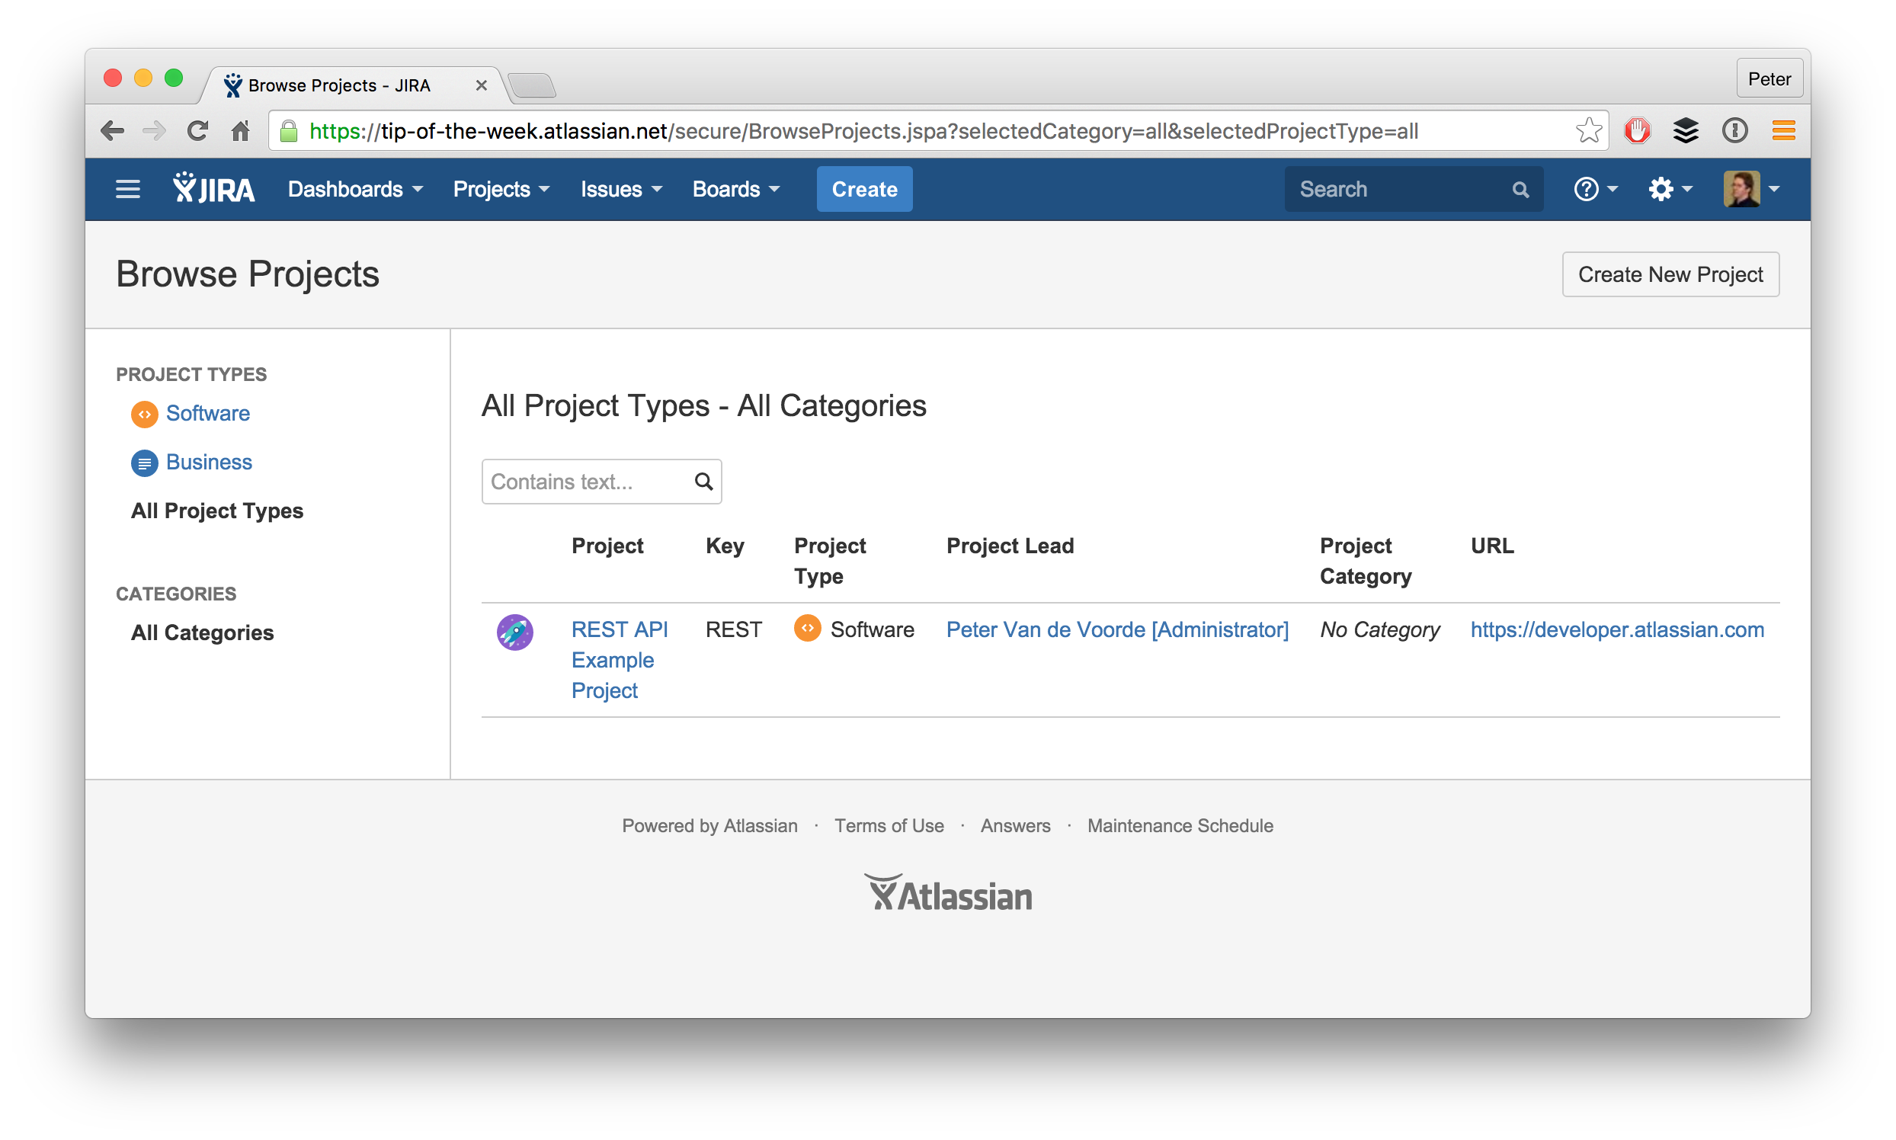
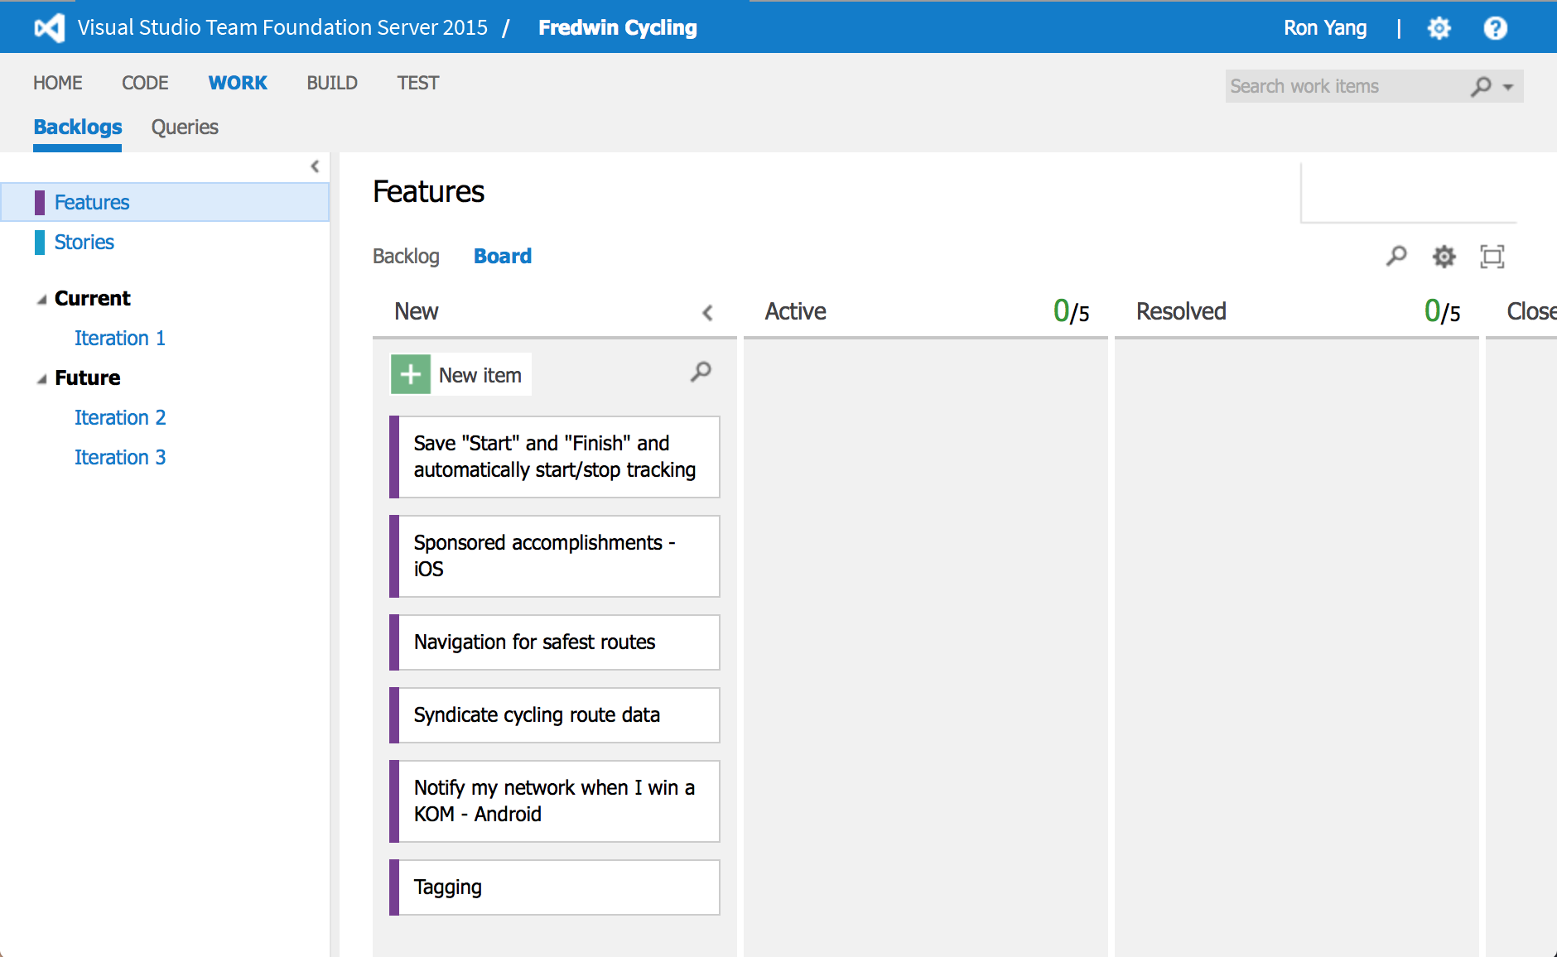
ONLINE TOOLS

Slide 20
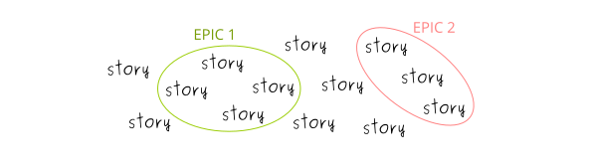
EPICS & STORIES
Epics – Big user story
User story – persona based requirement

Slide 21
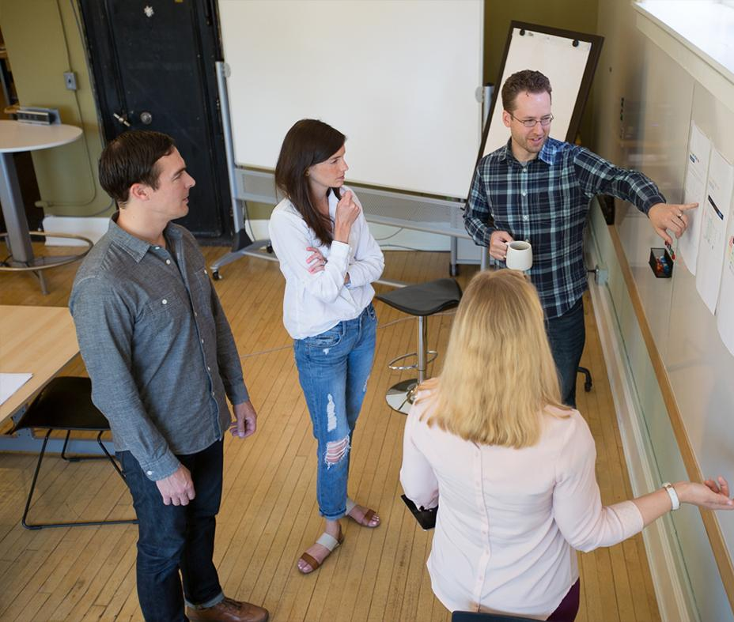
ACTIVITY
ACTIVITY
10 mins
Sprint 0
Run a workshop to gather the epics and stories that you will develop for your project
20 mins

Slide 22
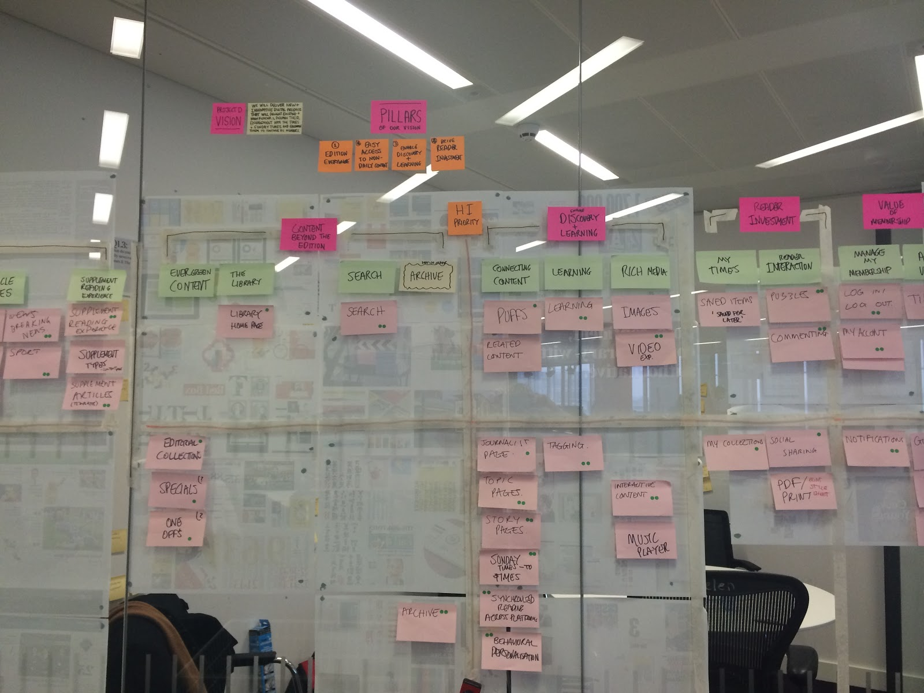
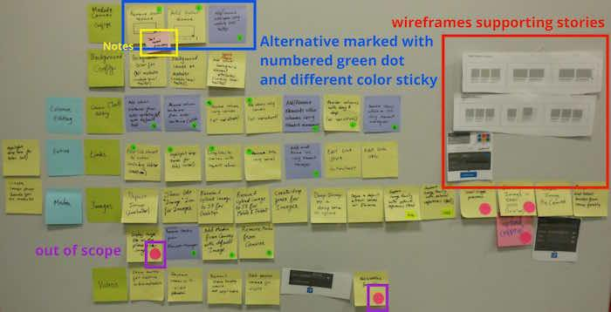
Story Map

Slide 23
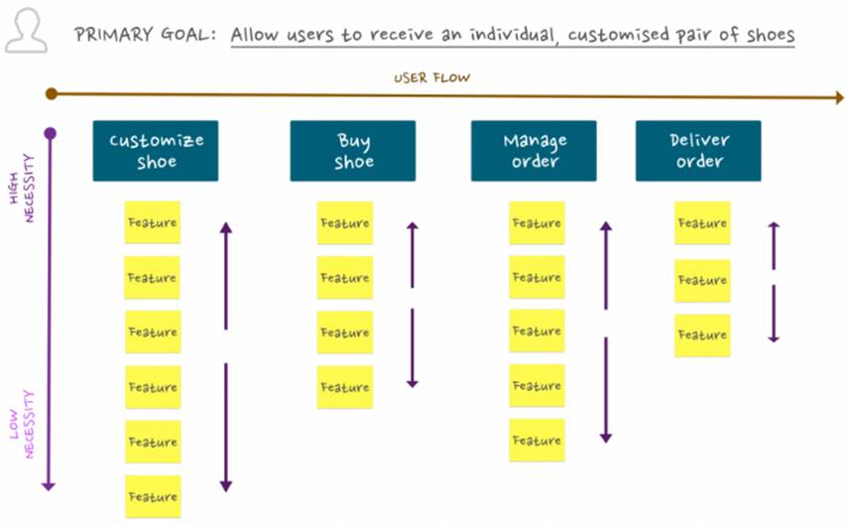
ACTIVITY
ACTIVITY
10 mins
Story Mapping
Categorise your epics and features into a logical flow
20 mins

Slide 24
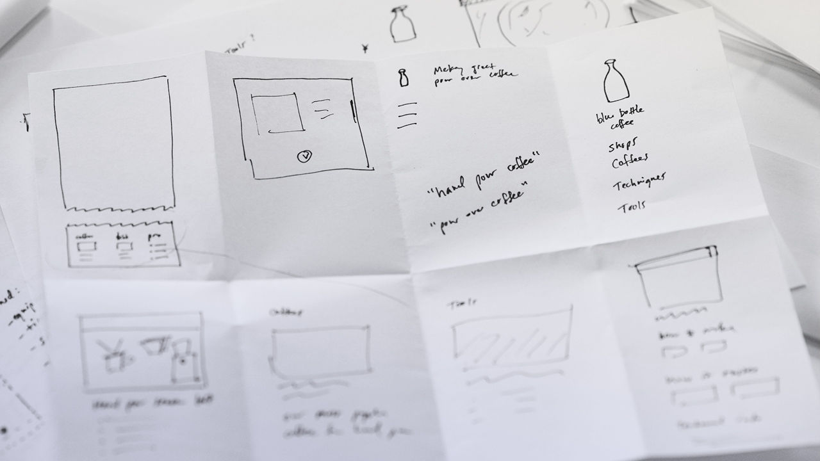
ACTIVITY
ACTIVITY
8 mins
Crazy 8s
Visualise your product
20 mins

Slide 25
LUNCH

Slide 26
ENERGISER

Slide 27

YOUR AGENDA - THE PRODUCT JOURNEY
Introduction
Agile refresh
What makes a good PO/PM?
Product vision
Prioritising the backlog
MVP/MLP
Refinement
Estimation
Managing a sprint
Product roadmap

Slide 28
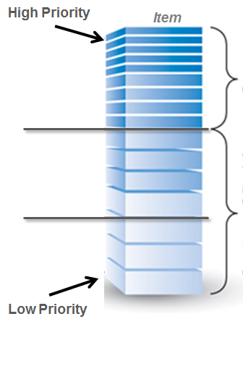
The Product Backlog
High Priority Items prioritized and a good level of detail provided
Mid Priority: Might prioritise features at this depth based on release schedule
Low Priority: Little effort goes into prioritizing items for furture releases

Slide 29
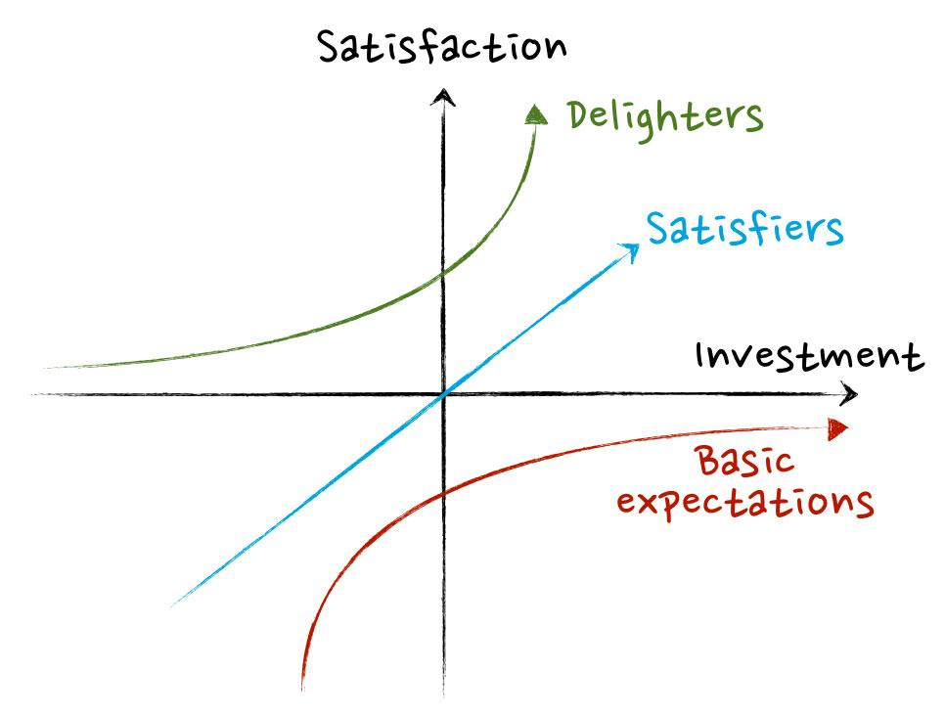
Kano model
‹#›

Slide 30
AGILE PRIORITISATION
HIGH
VALUE
X Priority
Low Risk
High Value
X Priority
High Risk
High Value
Value
X Priority
Low Risk
Low Value
X Priority
High Risk
Low Value
LOW
VALUE
LOW RISK
HIGH RISK
Risk
Notes:
All risk in an Agile project should be front loaded and therefore, there shouldn’t be an exponential curve of risk like waterfall projects, but instead a downward curve.

Slide 31

ACTIVITY
20 mins
PRIORITISATION
Use either Kano model or value vs risk to prioritise your backlog Why have you chosen to develop in your selected order? What were the factors that you thought of in making the decision?

Slide 32

YOUR AGENDA - THE PRODUCT JOURNEY
Introduction
Agile refresh
What makes a good PO/PM?
Product vision
Prioritising the backlog
MVP/MLP
Refinement
Estimation
Managing a sprint
Product roadmap

Slide 33
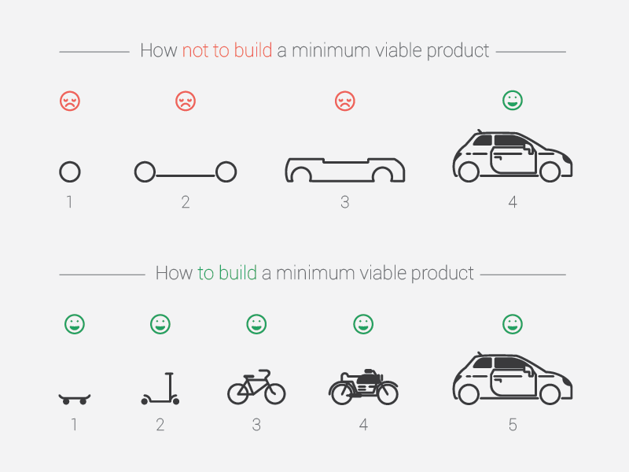
MVP & MLP
Notes:
Did you know that the Copy past function on the iPhone was only released in IOS 3?
People weren’t put off buying, and advocating the iPhone because it wasn’t there.
When developing a product, you must always be thinking about the MVP and Min Marketable Feature Set
•Customers don’t know what you haven’t delivered •Quick to market and early feedback
•Find the point where…If the feature is any smaller it wouldn’t be marketable
In order to create a product, it’s necessary to look into the future and anticipate how the product will function and what it will do. However, what’s the problem with looking into the future? It’s notoriously difficult and often our assumptions can be incorrect. The only thing certain about the future is that it is uncertain.
Investing in a new product involves risk around the following areas:
- Targeting the wrong market segment
Building an app that’s not wanted or outdated by the time it gets to market
Is the functionality within the app wanted by customers?
This is a risk reduction tool to allow for the product to be released early to customers with minimal cost ensuring that only the most important features are included in the first release.
Therefore, when developing an agile application, it’s possible to have the following items:
Minimum viable product – serves as a tool which allows customers to test the product as it is developed
Minimum marketable product - A product that is complete enough for general release
As the agile process relies on feedback, throughout the stages of having both a MVP and MMP, there should be a feedback loop with customers, ensuring that bugs and requests that are identified are prioritised into the product backlog for the team to sprint on.
You are not wasting time and money of features customers don’t need and won’t use.

Slide 34

Draw an MVP line for your product HINT: be as brutal as possible - the more you have to build, the longer it will take to deliver the product
ACTIVITY
5 mins

Slide 35


YOUR AGENDA - THE PRODUCT JOURNEY
Introduction
Agile refresh
What makes a good PO/PM?
Product vision
Prioritising the backlog
MVP/MLP
Refinement
Estimation
Managing a sprint
Product roadmap

Slide 36

I’m glad we all agree
?

Slide 37

A good user story is…
Independent (of all other)
Negotiable (not a fixed solution)
Valuable (a vertical slice)
Estimatable (to an approximation)
Small (enough to fit into a sprint)
Testable (once completed)

Slide 38
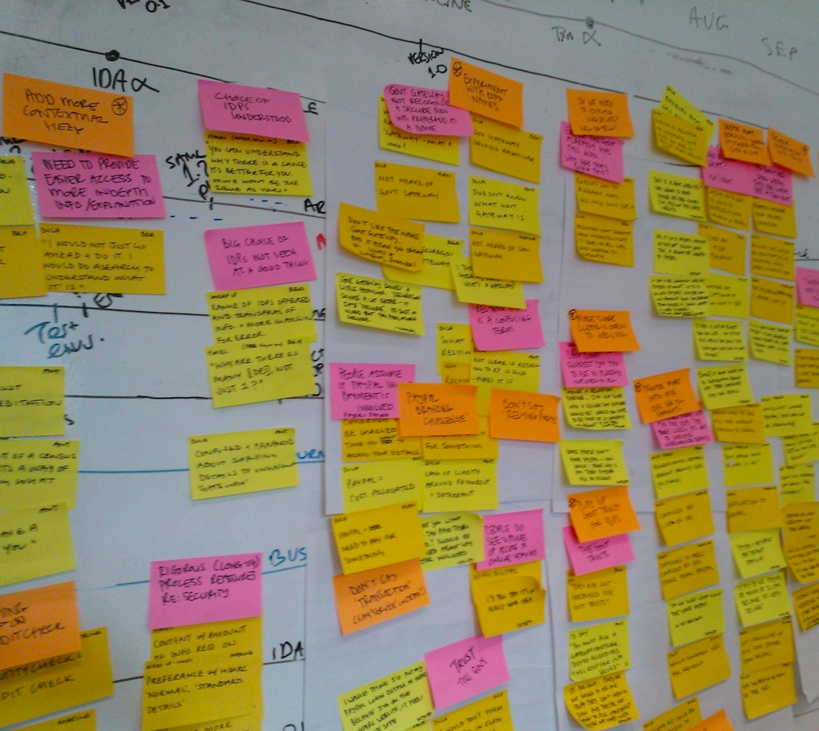
User Stories
Written from the perspective of a customer
Describes the goal not just the requirement
Stimulates conversation – not overly prescriptive
Vertical slices of functionality eg. Databases should not be called out in a story
Small enough for the sprint ie. 1-5 days worth of work
As a [persona] I want [requirement] so that [goal]
Eg. As a Managed Service BA I would like to log my time into a time tracking tool so that I can be paid for the time I work
Notes:
Sprint Cards
A user story is...
During the sprint planning meetings, the team selects some of the product backlog items, usually in the form of user stories, and identifies the tasks necessary to complete each story. The team will also estimate how long each task will take to complete. It is essential the team themselves choose the items and size of the sprint, as they are the people committing to completing the tasks.
These items for the sprint backlog - a list of tasks identified by the Scrum team to be completed during the Scrum sprint.
When the team agrees to tackle the work, the Product Owner might physically write the story on a post-it note or index card or it might be virtual. This forms a sprint or story card.
A sprint or story card is usually just a title with a few lines of text.
It can later be placed on a kanban board to track progress.

Slide 39

ACCEPTANCE CRITERIA
As a consultant I want to log my time into a time-tracking tool so that I can be paid for the time I work
Scenario: Submit actuals into the timesheet
Given I am an NH BA or consultant
When I submit time I’ve worked this week into the time tracking tool
THEN send it for approval to my assigned manager
AND send an email to them weekly with a roundup of all time entry that they need to approve

Slide 40
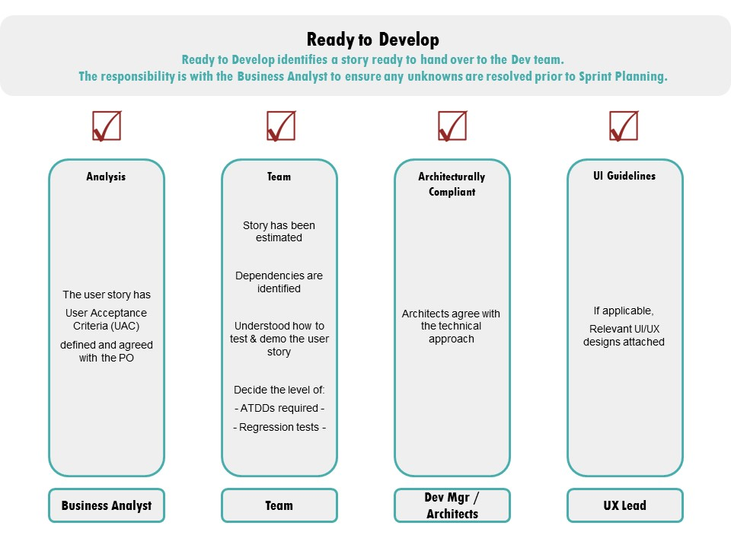
Definition of Ready

Slide 41
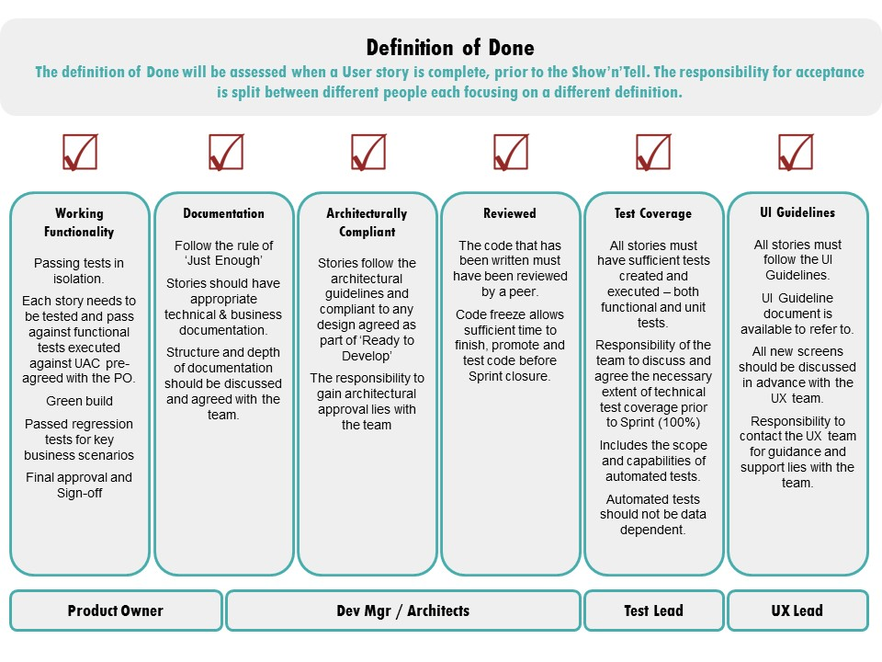
Definition of Done

Slide 42
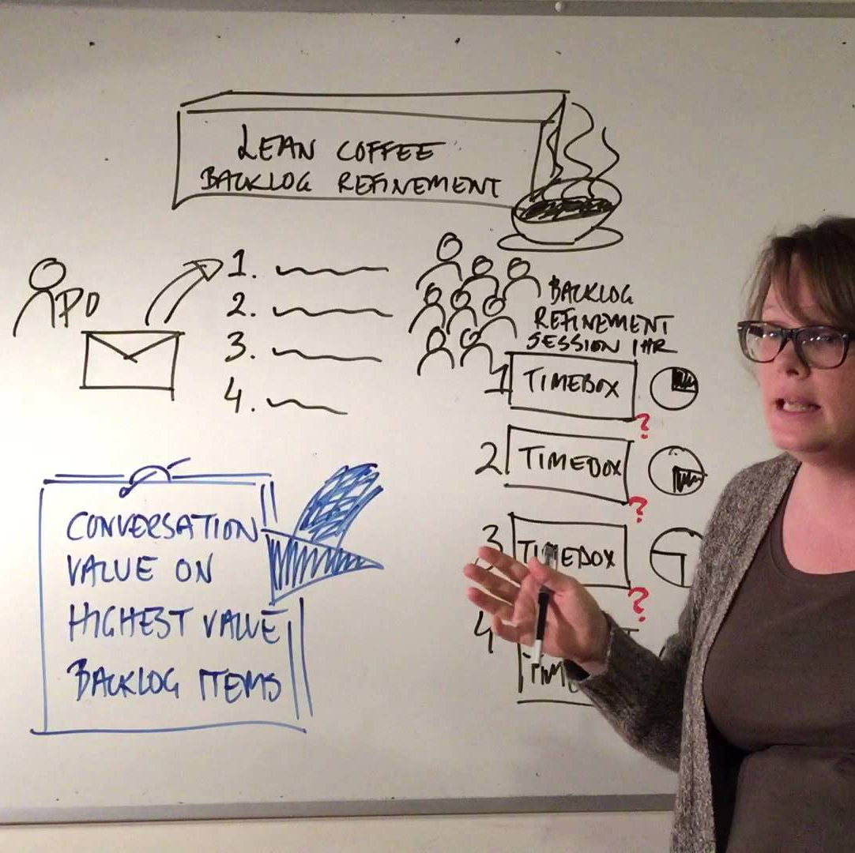
User stories Now that you have your prioritised stories, it’s time to refine the backlog. Using the ‘As a…I want…So that’ template, change your high level features for MVP into user stories and add acceptance criteria
EXERCISE
20 mins

Slide 43
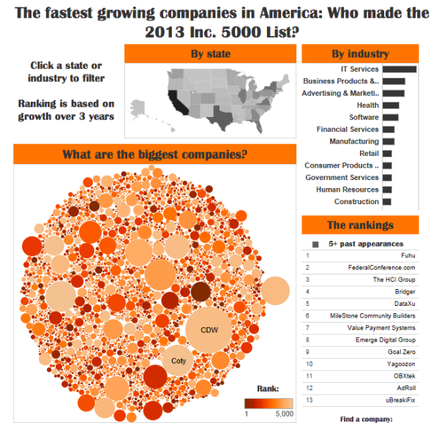
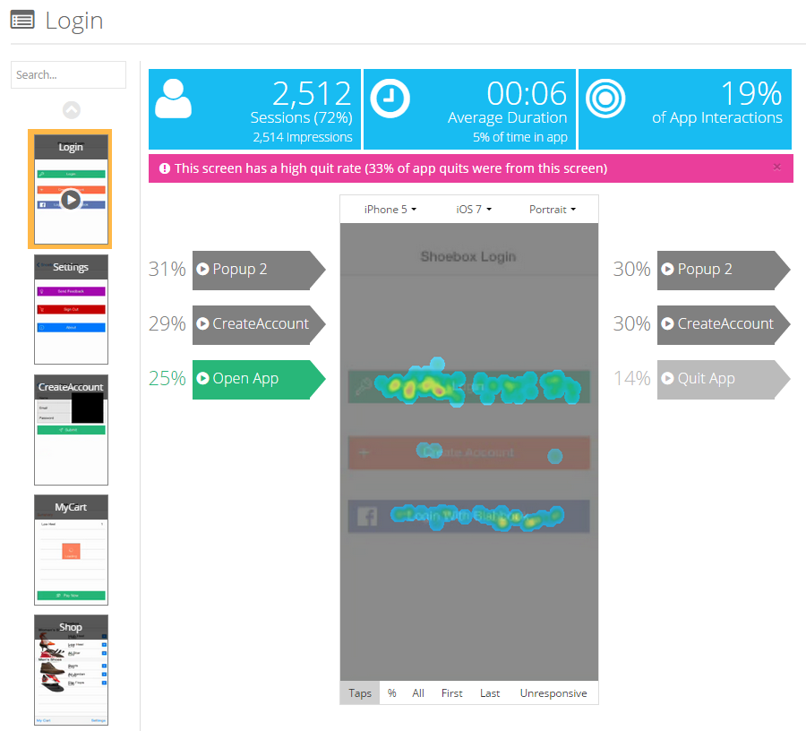
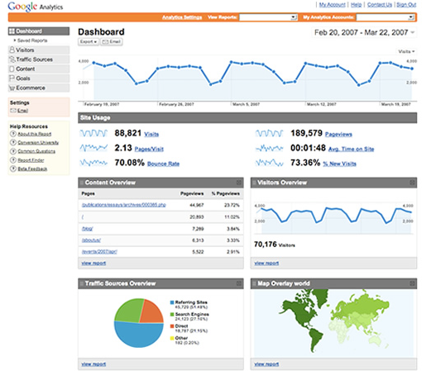
ANALYTICS

Slide 44
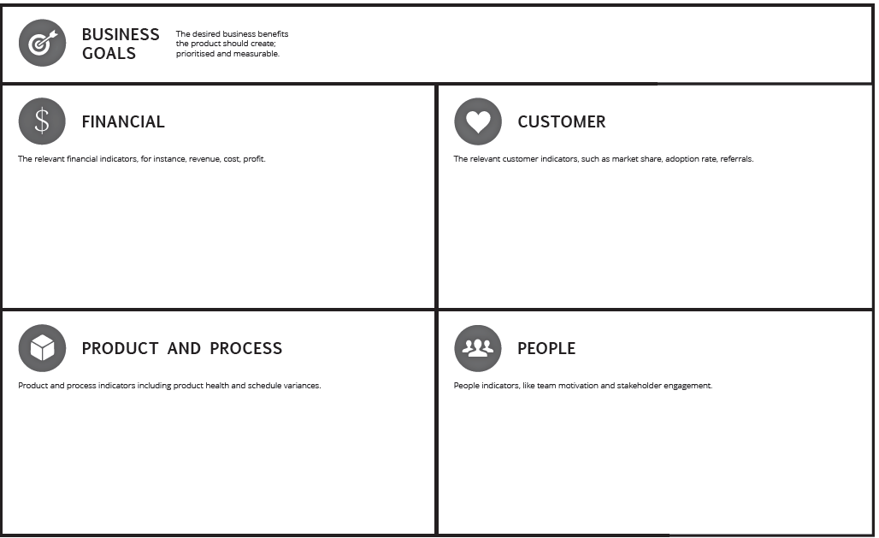
PRODUCT SCORECARD

Slide 45



Product Analytics Select which analytics you would want to track for launch to help you realise your product goals.
ACTIVITY
15 mins

Slide 46

YOUR AGENDA - THE PRODUCT JOURNEY
Introduction
Agile refresh
What makes a good PO/PM?
Product vision
Prioritising the backlog
MVP/MLP
Refinement
Estimation
Managing a sprint
Product roadmap

Slide 47


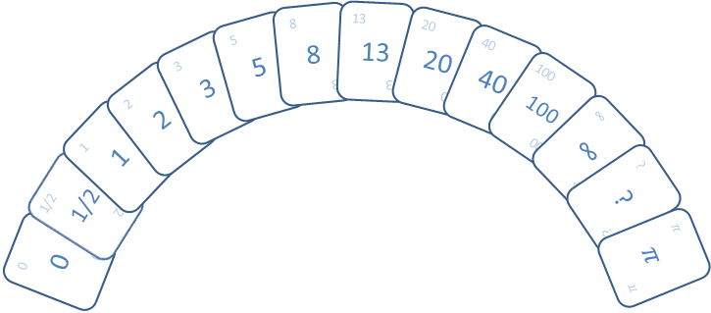
ESTIMATION
Notes:
T-Shirt Sizes Small / Medium / Large / XL / XXL
+ quick and easy – often used for Epics
- non numeric - can’t be used to track Velocity
Story Points via Poker Planning – most popular
+ Quick and easy to do – purely relative
+ Removes disparity of different skill levels
Ideal Days – pure effort without overhead
- tends to draw you into detailed task estimates
- takes longer to complete – normally completed during sprint planning

Slide 48

PLANNING POKER 1. Select a PO from the team (everyone else is a part of the team) 2. As a team, select 1 or 2 benchmark stories to help estimate the size of other stories 3. USE THE CARDS TO VOTE Team Hint: As a team, think of what could be involved eg. What are the fringe cases of the functionality that is being delivered? Ask yourselves as POs how it should be incorporated.
ACTIVITY
15 mins

Slide 49

YOUR AGENDA - THE PRODUCT JOURNEY
Introduction
Agile refresh
What makes a good PO/PM?
Product vision
Prioritising the backlog
MVP/MLP
Refinement
Estimation
Managing a sprint
Product roadmap

Slide 50

CEREMONIES
Daily scrum
Sprint review
Sprint retrospective
Sprint planning

Slide 51
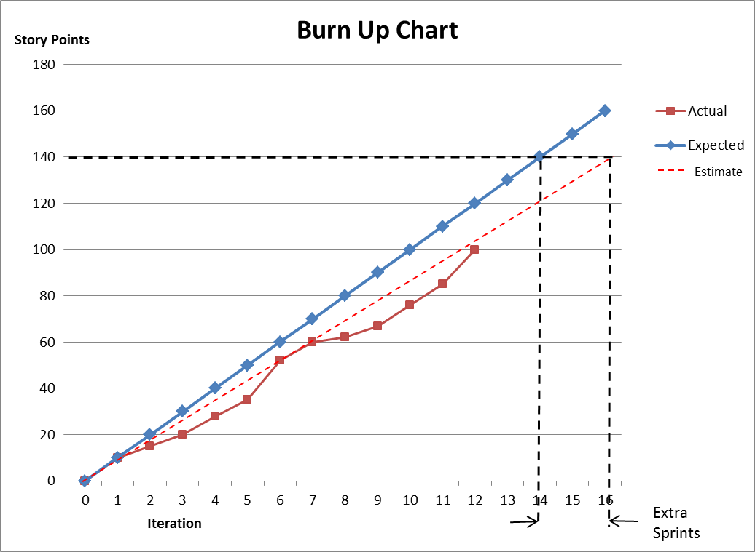
BURNDOWN CHARTS
Notes:
Graphical representation of progress in a sprint
Ideal work line used as a guideline
Actual work line will fluctuate above and below the idea work line
Accessible to all team members
Updated daily
Always depends on accuracy of original estimates

Slide 52
RELEASE MANAGEMENT
Continuous Delivery
Code done
Unit tests
Integrate
Acceptance test
Deploy to production
Auto
Auto
Auto
Manual
Continuous Deployment
Code done
Unit tests
Integrate
Acceptance test
Deploy to production
Auto
Auto
Auto
Auto

Slide 53

YOUR AGENDA - THE PRODUCT JOURNEY
Introduction
Agile refresh
What makes a good PO/PM?
Product vision
Prioritising the backlog
MVP/MLP
Refinement
Estimation
Managing a sprint
Product roadmap

Slide 54
BUILDING YOUR PRODUCT ROADMAP
Focus on goals and benefits
Tell a coherent story
Keep it simple
Secure buy in from all stakeholders
Have the courage to say no
Know when to show dates
Make it measurable
Determine cost top down
Review and adjust regularly
Make it visible

Slide 55
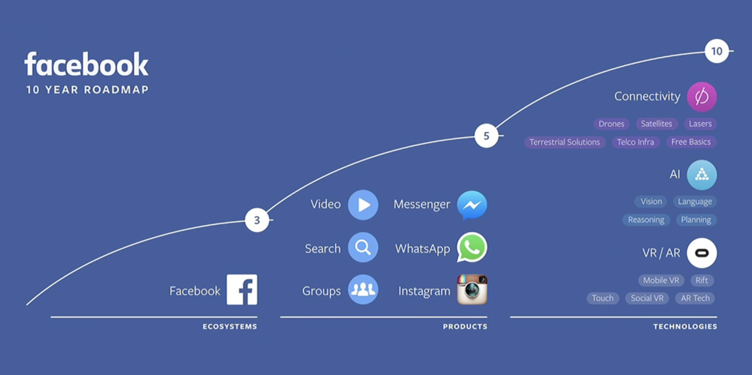
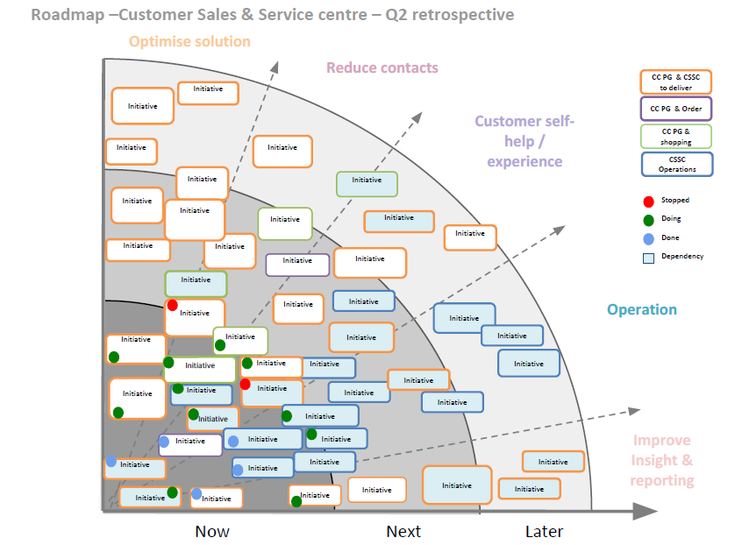
ROADMAP VISUALISATION

Slide 56
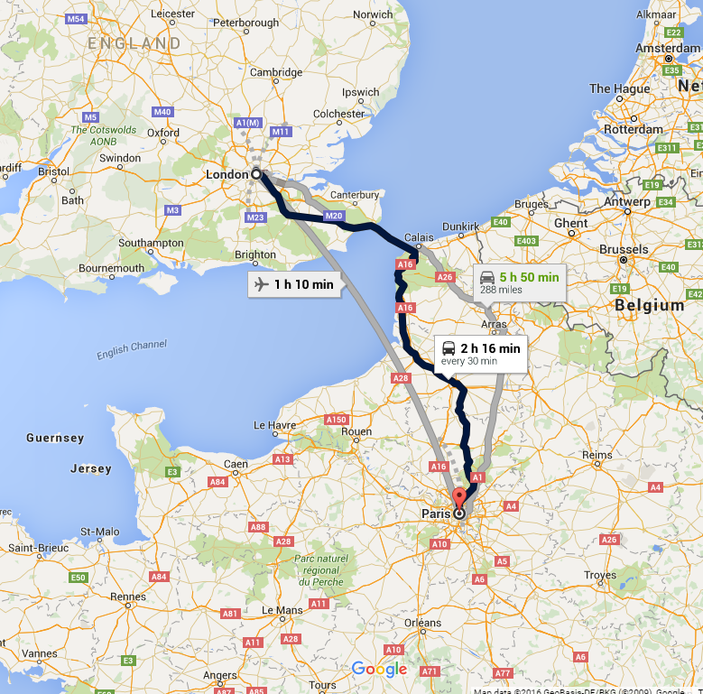
BUILD YOUR ROADMAP Choose template, build a 1 year roadmap
ACTIVITY
15 mins

Slide 57
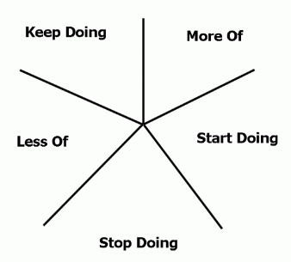
Team Retrospective Retro format: Starfish
ACITIVITY
15 mins

Slide 58

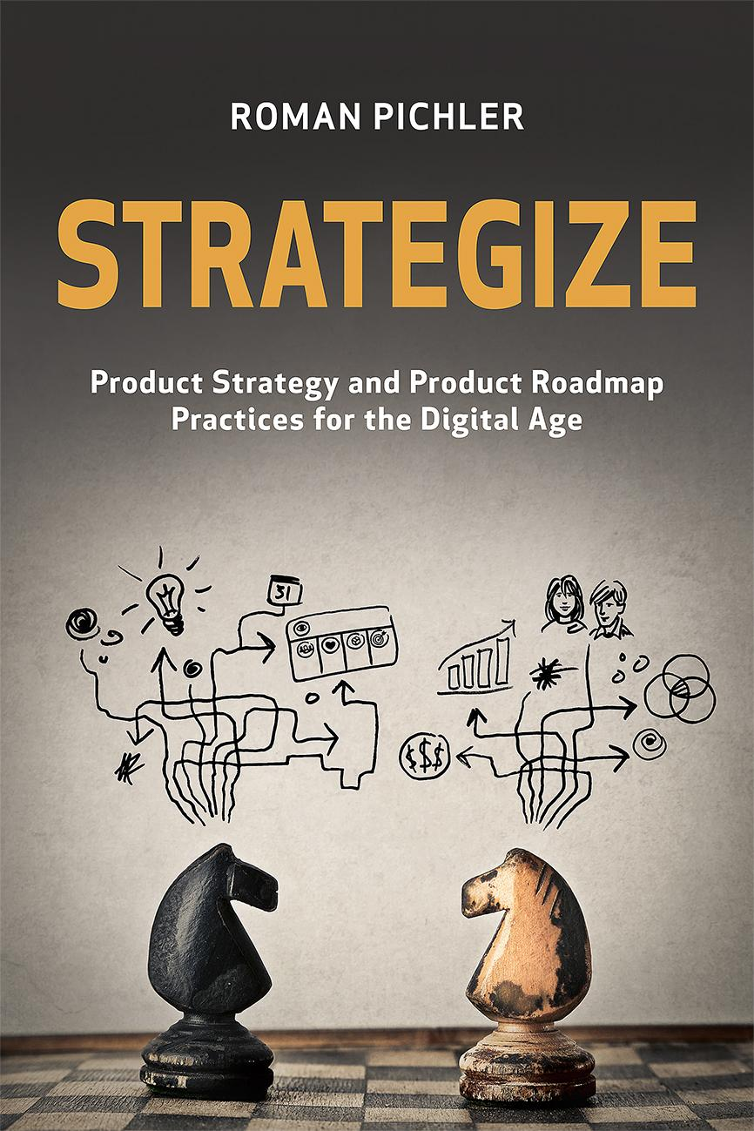
FURTHER READING

Slide 59
QUESTIONS?

